Slide 1


Bob Tumushiime
29-March-2024

Slide 2

Outline
Executive Summary
Introduction
Methodology
Results
Conclusion
Appendix

Slide 3
Executive Summary
Summary of methodologies
Data Collection through API
Data Collection with Web Scraping
Data Wrangling
Exploratory Data Analysis with SQL
Exploratory Data Analysis with Data Visualization
Interactive Visual Analytics with Folium
Machine Learning Prediction
Summary of all results
Exploratory Data Analysis results
Interactive analytics in screenshots
Predictive Analytics result

Slide 4
Introduction
Project Definition and Context
Worked on a new rocket company named "SpaceY" that would like to compete with SpaceX founded by Billionaire industrialist Ellon Musk. Space X advertises Falcon 9 rocket launches on its website with a cost of 62 million dollars; other providers cost upward of 165 million dollars each, much of the savings is because Space X can reuse the first stage. Therefore if we can determine if the first stage will land, we can determine the cost of a launch.
Solutions
- Find the features that affect the first stage landing success
- predict if the first stage will land successfully

Slide 5

Section 1

Slide 6
Methodology
Executive Summary
Data collection methodology:
- Collected the rocket launch data from the SpaceX API
- Collected Falcon 9 historical launch records using Web scraping
Performed data wrangling:
- Used one hot encoding to deal with categorical data
Performed exploratory data analysis (EDA) using visualization and SQL
Performed interactive visual analytics using Folium and Plotly Dash
Performed predictive analysis using classification models

Slide 7
Data Collection
Collected the rocket launch data from the SpaceX API
Web-scraped the SpaceX table in the Wikipedia page to collect Falcon 9 historical launch records

Slide 8
Data Collection – SpaceX API
the GitHub URL https://github.com/bobhunk/New_Rocket_Company_Project_Bob/blob/main/collectingTheData.ipynb

Slide 9
Data Collection - Scraping
The GitHub URL: https://github.com/bobhunk/New_Rocket_Company_Project_Bob/blob/main/collectingTheData-webscraping.ipynb

Slide 10
Data Wrangling
Calculated the number of launches on each site
Calculated the number and occurrence of each orbit
Calculated the number and occurrence of mission outcome per orbit type
Created a landing outcome label from Outcome column
The GitHub URL: https://github.com/bobhunk/New_Rocket_Company_Project_Bob/blob/main/Data%20wrangling.ipynb

Slide 11
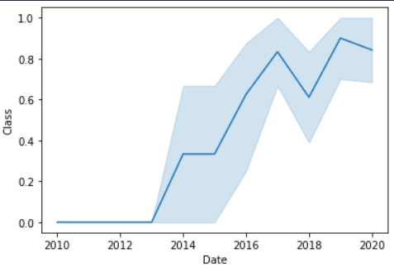
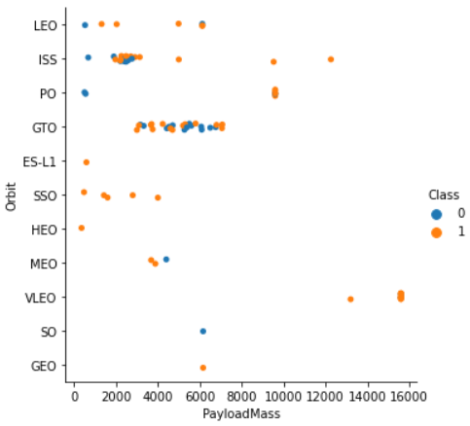
EDA with Data Visualization
Visualized the relationship between the date and the average success rate across the years.
Conclusion: the success rate since 2013 kept increasing till 2020
The GitHub URL:https://github.com/bobhunk/New_Rocket_Company_Project_Bob/blob/main/eda-dataviz.ipynb
Visualized the relation between the Orbit and the payload mass.
Conclusion: With heavy payloads the successful landing or positive landing rate are more for Polar, LEO and ISS.

Slide 12
EDA with SQL
Loaded the SpaceX dataset into a sqllite database.
Applied EDA with SQL to get insight from the data. Wrote queries to find out for instance:
The names of unique launch sites in the space mission.
The total payload mass carried by boosters launched by NASA (CRS)
The average payload mass carried by booster version F9 v1.1
The total number of successful and failure mission outcomes
The failed landing outcomes in drone ship, their booster version and launch site names.
The GitHub URL: https://github.com/bobhunk/New_Rocket_Company_Project_Bob/blob/main/eda-sql.ipynb

Slide 13
Build an Interactive Map with Folium
Finding an optimal location for building a launch site certainly involves many factors and hopefully we could discover some of the factors by analyzing the existing launch site locations.
Marked all launch sites, and added map objects such as markers, circles, lines to mark the success or failure of launches for each site on the folium map.
Using the color-labeled marker clusters, I identified which launch sites have relatively high success rate.
Calculated the distances between a launch site to its proximities. We answered some question for instance:
Are launch sites near railways, highways and coastlines.
Do launch sites keep certain distance away from cities.
The GitHub URL: https://github.com/bobhunk/New_Rocket_Company_Project_Bob/blob/main/site_location.ipynb

Slide 14
Build a Dashboard with Plotly Dash
Built an interactive dashboard with Plotly dash
Plotted pie charts showing the total launches by a certain sites
Plotted scatter graph showing the relationship with Outcome and Payload Mass (Kg) for the different booster version.
The GitHub URL:

Slide 15
Predictive Analysis (Classification)
Loaded the data using numpy and pandas, transformed the data, split the data into training and testing.
Built different machine learning models and tune different hyperparameters using GridSearchCV.
Used accuracy as the metric for our model, improved the model using feature engineering and algorithm tuning.
Found the best performing classification model.
The GitHub URL: https://github.com/bobhunk/New_Rocket_Company_Project_Bob/blob/main/Machine%20Learning%20Prediction.ipynb

Slide 16
Results
Exploratory data analysis results
Interactive analytics demo in screenshots
Predictive analysis results

Slide 17

Section 2

Slide 18
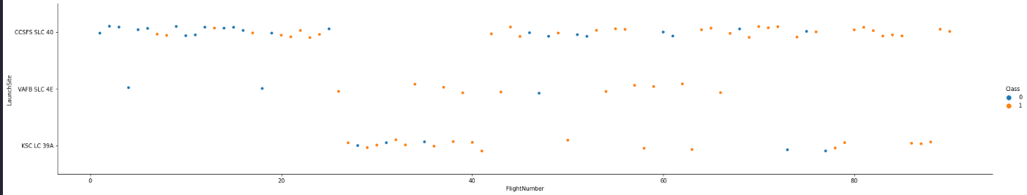
Flight Number vs. Launch Site
Show a scatter plot of Flight Number vs. Launch Site
Explanation: when the flight number is > 80 the success rate is 100%

Slide 19
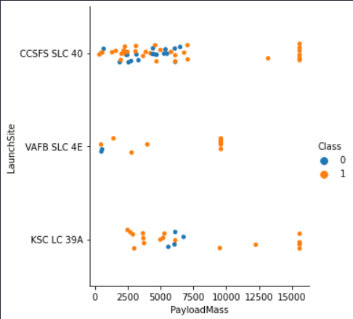
Payload vs. Launch Site
Show a scatter plot of Payload vs. Launch Site
Explanation: the VAFB-SLC launchsite there are no rockets launched for heavy payload mass(greater than 10000).

Slide 20
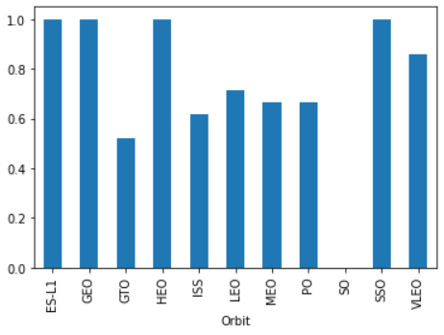
Success Rate vs. Orbit Type
Show a bar chart for the success rate of each orbit type
Explanation: The ES-L1, GEO, HEO and SSO orbit have the maximum success rate.

Slide 21
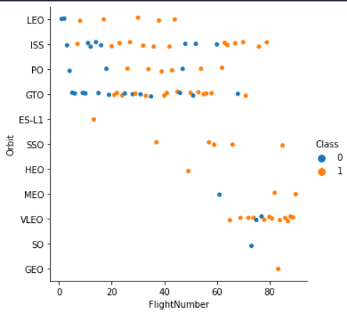
Flight Number vs. Orbit Type
Show a scatter point of Flight number vs. Orbit type
Explanation: In the LEO orbit the Success appears related to the number of flights; on the other hand, there seems to be no relationship between flight number when in GTO orbit.

Slide 22
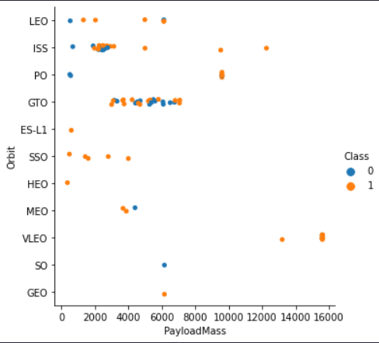
Payload vs. Orbit Type
Show a scatter point of payload vs. orbit type
Explanation: With heavy payloads the successful landing or positive landing rate are more for Polar,LEO and ISS.
However for GTO we cannot distinguish this well as both positive landing rate and negative landing(unsuccessful mission) are both there here.

Slide 23
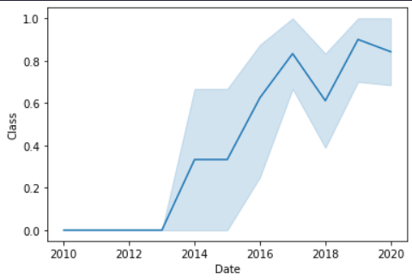
Launch Success Yearly Trend
Show a line chart of yearly average success rate
Explanation: the success rate since 2013 kept increasing till 2020

Slide 24
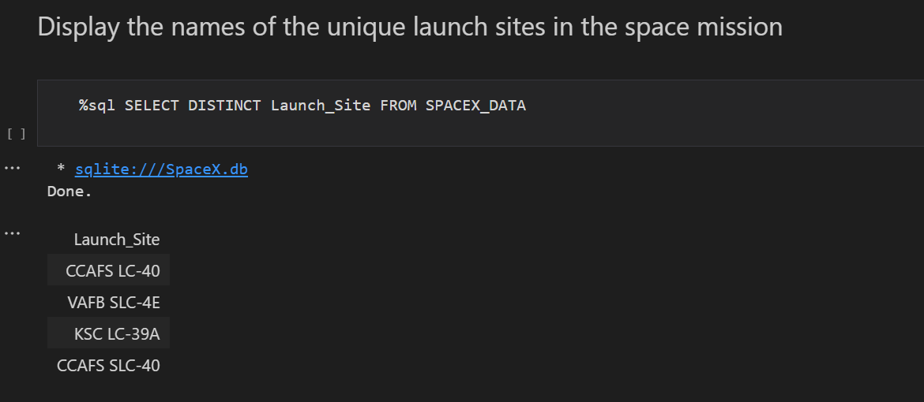
All Launch Site Names

Slide 25
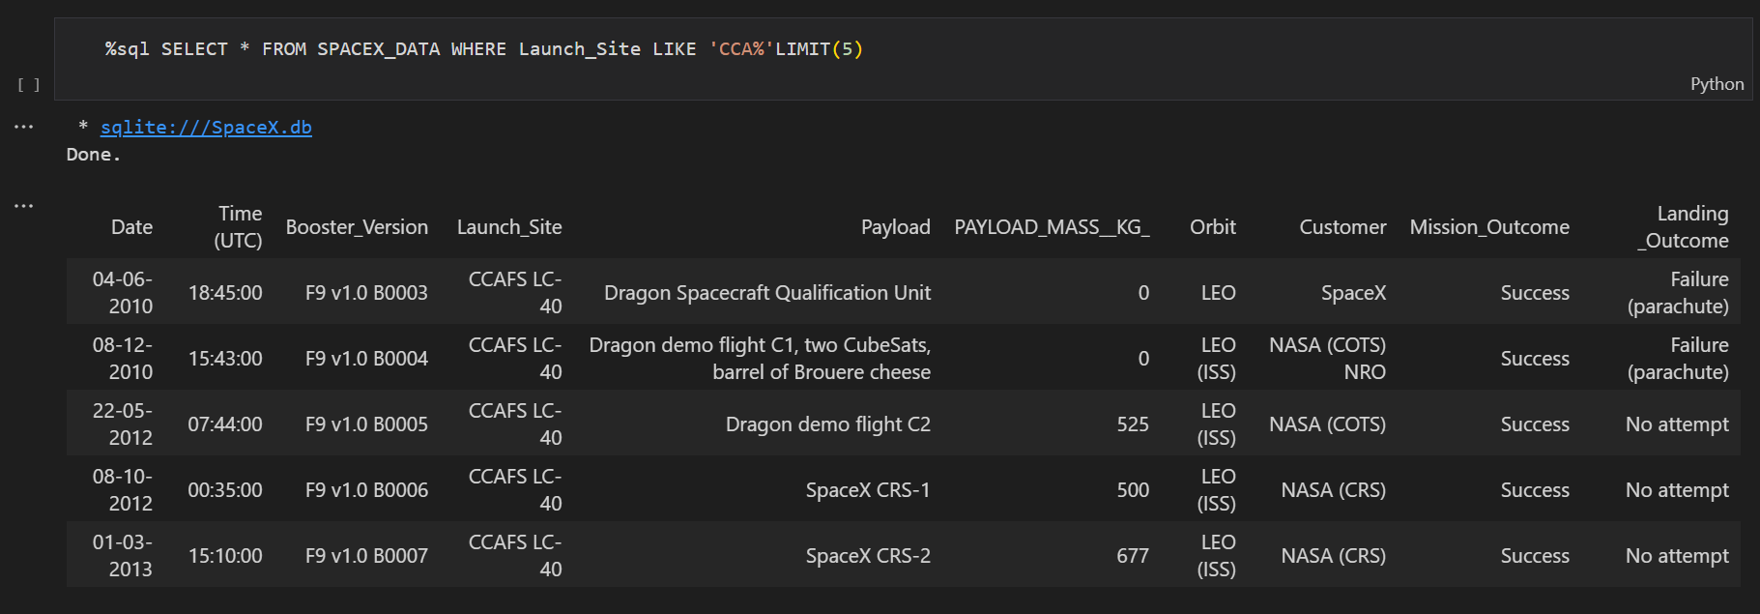
Launch Site Names Begin with 'CCA'

Slide 26
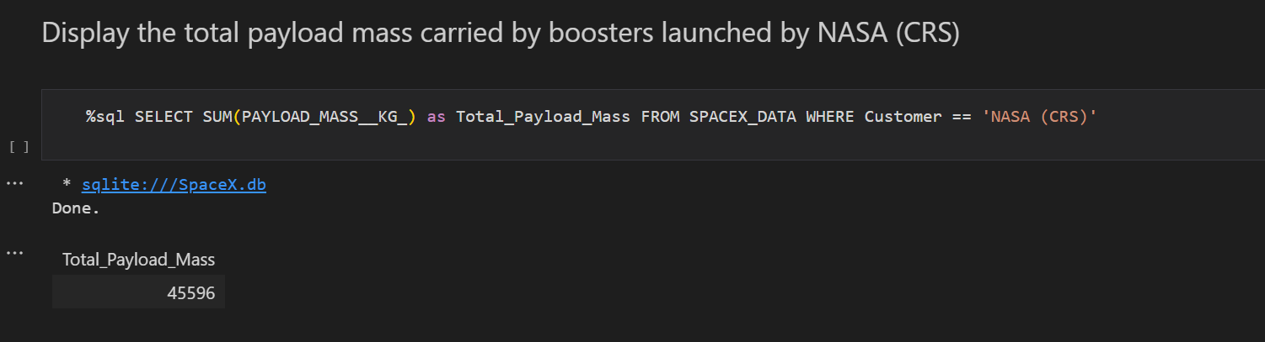
Total Payload Mass

Slide 27
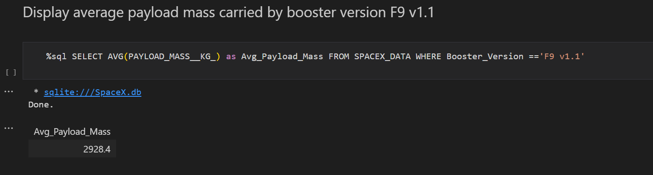
Average Payload Mass by F9 v1.1

Slide 28
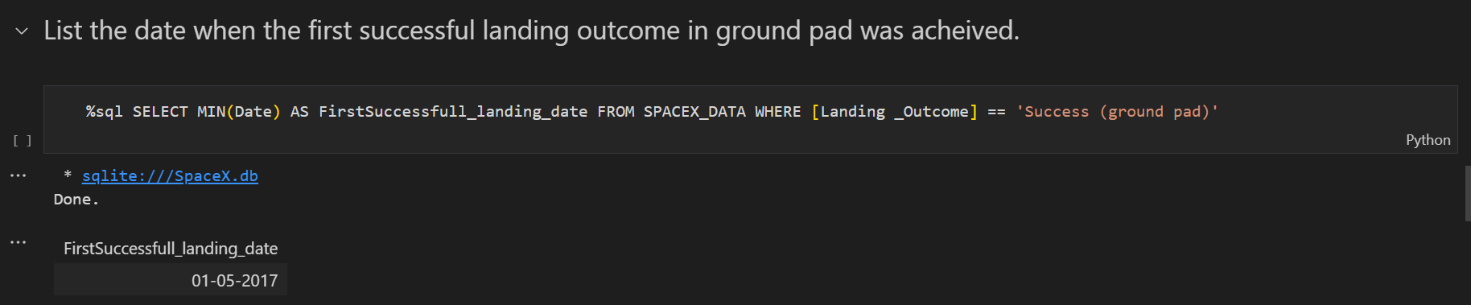
First Successful Ground Landing Date

Slide 29
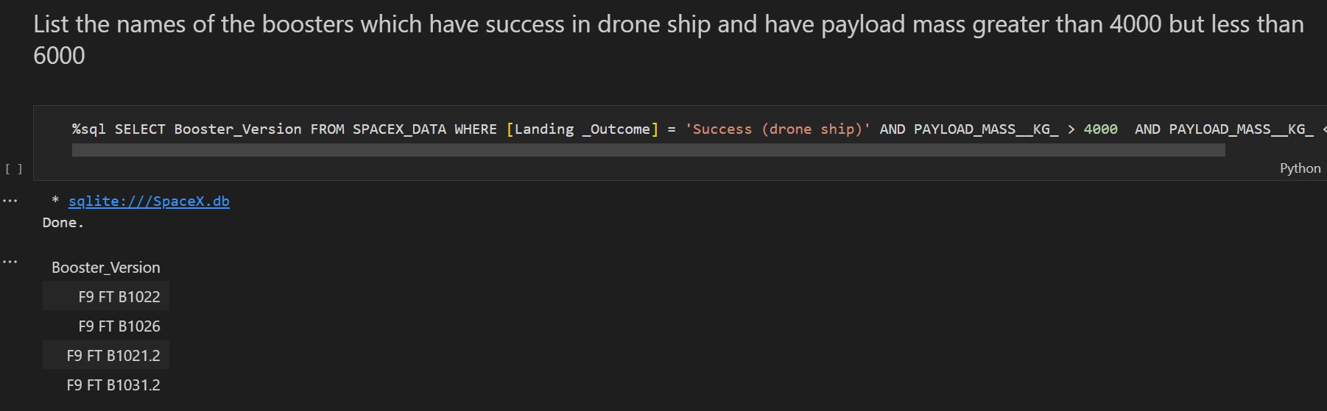
Successful Drone Ship Landing with Payload between 4000 and 6000

Slide 30
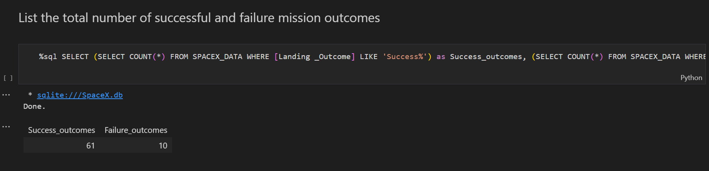
Total Number of Successful and Failure Mission Outcomes

Slide 31
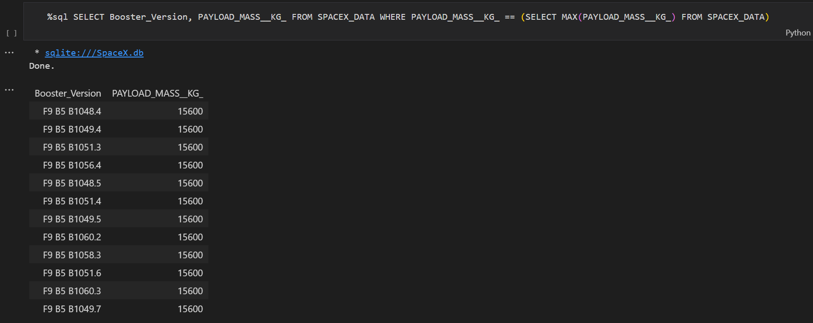
Boosters Carried Maximum Payload

Slide 32
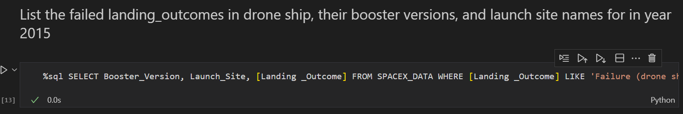
2015 Launch Records
List the failed landing_outcomes in drone ship, their booster versions, and launch site names for in year 2015

Slide 33
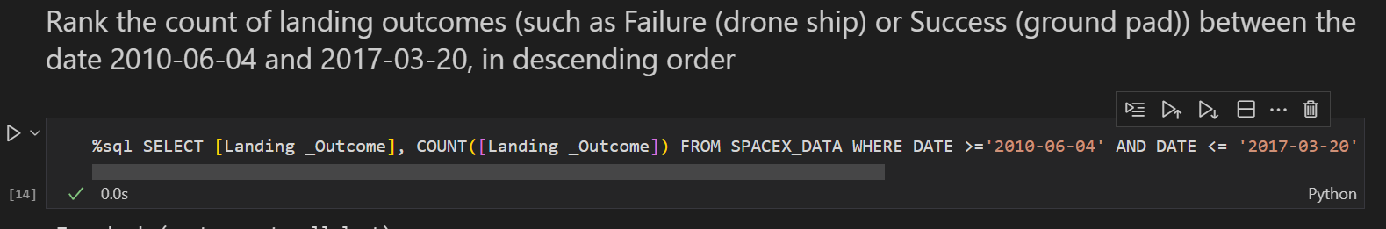
Rank Landing Outcomes Between 2010-06-04 and 2017-03-20
Rank the count of landing outcomes (such as Failure (drone ship) or Success (ground pad)) between the date 2010-06-04 and 2017-03-20, in descending order

Slide 34

Section 3

Slide 35
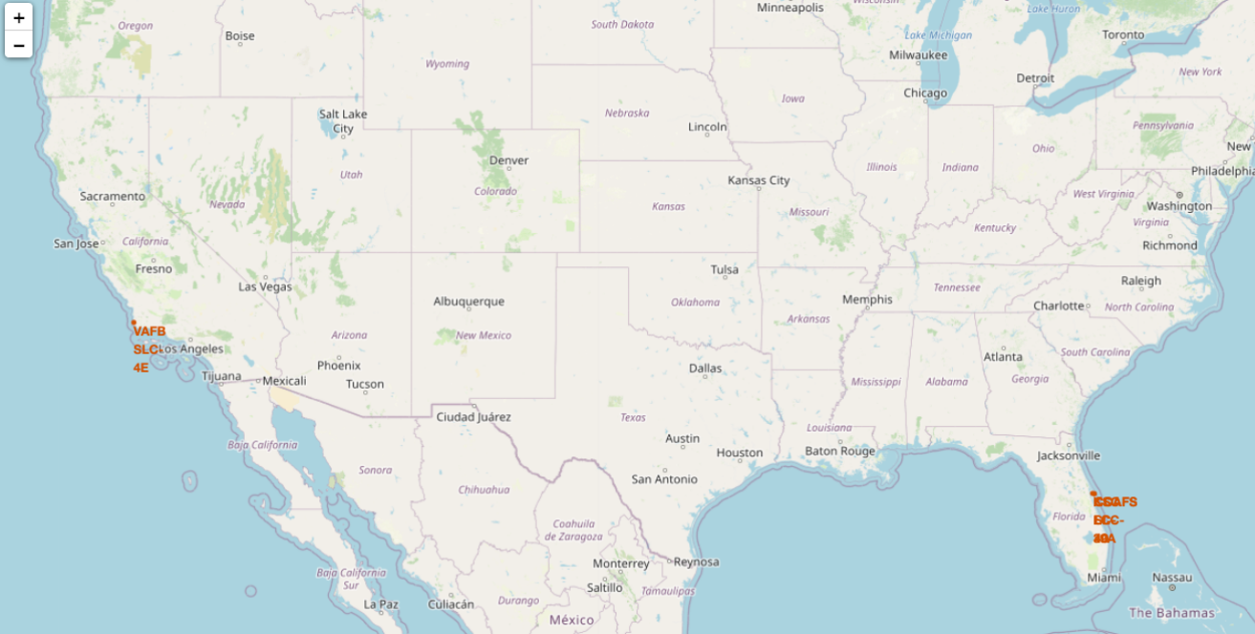
All launch sites global map markers

Slide 36
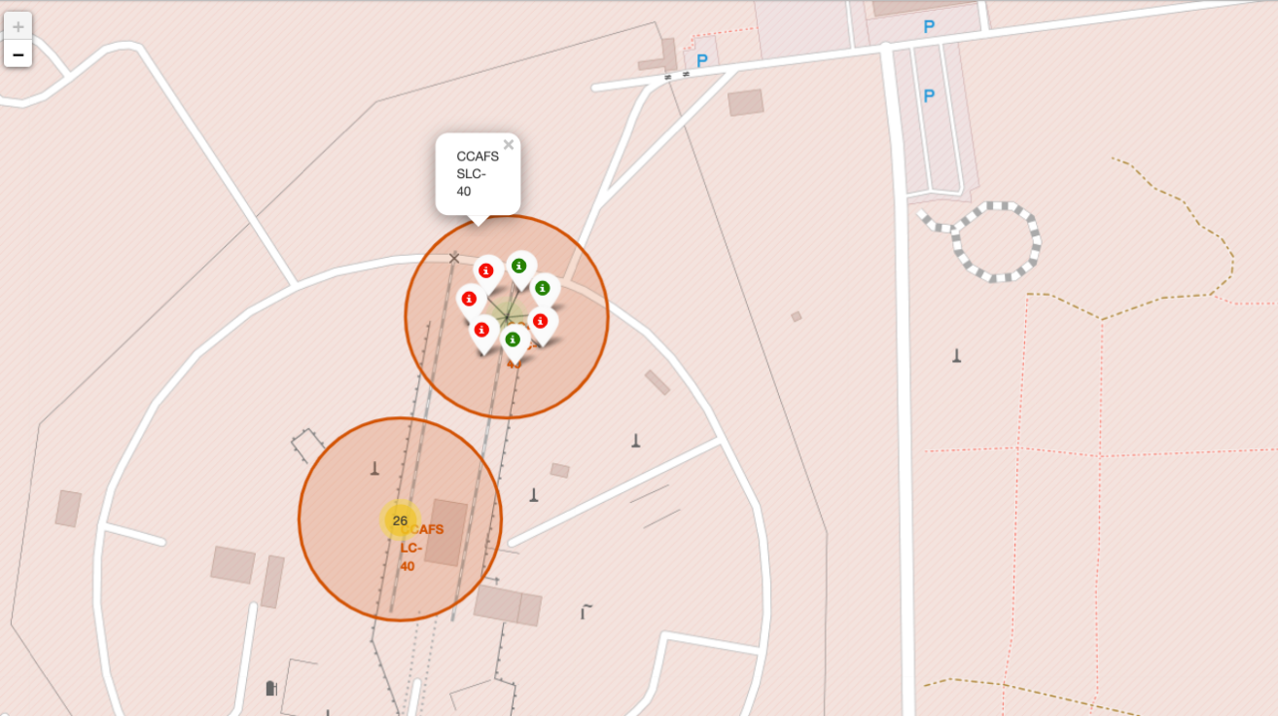
Markers showing launch sites with color labels

Slide 37
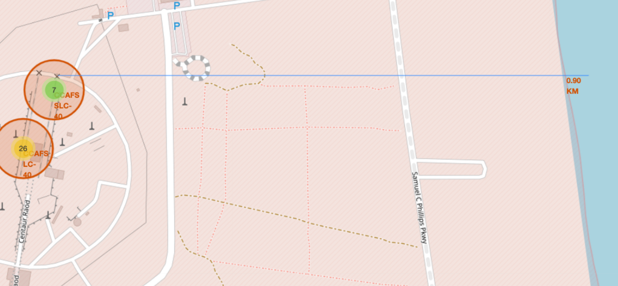
Launch Site distance to landmarks

Slide 38

Section 4

Slide 39

Pie chart showing the success percentage achieved by each launch site
We conclude that the KSC LC-39A have the most successful launches

Slide 40
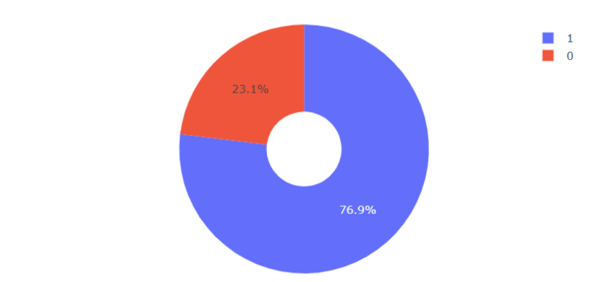
Pie chart showing the Launch site with the highest launch success ratio
the KSC LC-39A success is 76.9%

Slide 41
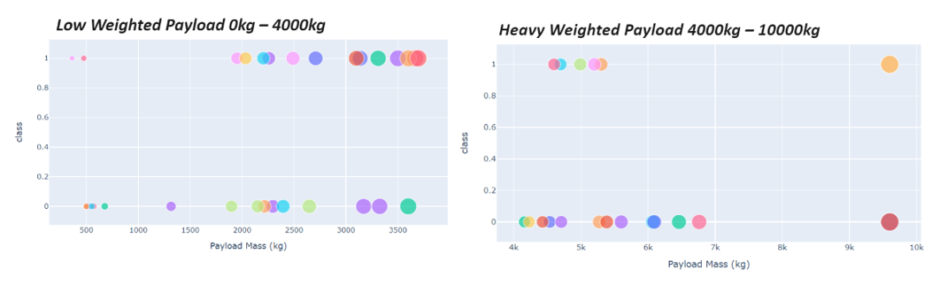
Scatter plot of Payload vs Launch Outcome for all sites, with different payload selected in the range slider
The success rate of low weighted payload is higher than high weighted payload

Slide 42

Section 5

Slide 43
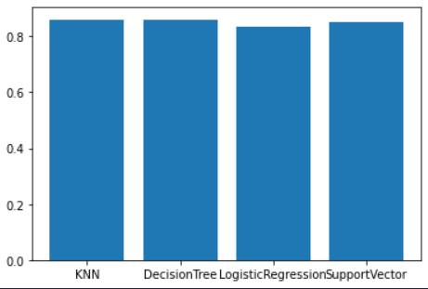
Classification Accuracy
Visualize the built model accuracy for all built classification models, in a bar chart
Find which model has the highest classification accuracy: KNN

Slide 44
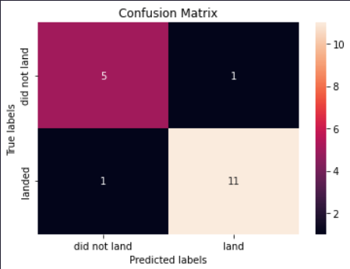
Confusion Matrix
The knn model classify well the True positive and True negative and the percentage of False positive and false negative is too small.

Slide 45
Conclusions
The larger the flight amount at a launch site, the greater the success rate at a launch site.
Launch success rate started to increase in 2013 till 2020.
Orbits ES-L1, GEO, HEO, SSO, VLEO had the most success rate.
KSC LC-39A had the most successful launches of any sites.
The KNN classifier is the best machine learning algorithm for this task.

Slide 46
Appendix
Data Collected Links:
https://github.com/bobhunk/New_Rocket_Company_Project_Bob/blob/main/dataset_part_1.csv
https://github.com/bobhunk/New_Rocket_Company_Project_Bob/blob/main/dataset_part_2.csv
https://github.com/bobhunk/New_Rocket_Company_Project_Bob/blob/main/dataset_part_3.csv

Slide 47


